Slide 1
Intro to GFW and Big Query
SFG team workshop
11/16/2017

Slide 2
Proposed Agenda
9-10 am: Overview of AIS and GFW
10- 11 am:Intro to Big Query and Cloud Storage
11 - 12 pm: Basic queries and different workflows
12 - 1pm: More advanced and common queries

Slide 3
Overview of GFW
Taps into existing satellite technology intended to protect life at sea and avoid collisions
~400K vessels
~80K fishing vessels
24 Billion messages since 2012
40 million messages added each day

Slide 4
Overview of GFW
There are two (soon 3) GFW worlds:
Public facing platform
great for visualization and exploration
Easy to use and dazzle folks
http://globalfishingwatch.org/map/
Raw data
Access to the semi-processed data the feed the online platform
Available for a selected group of research institutions
Infinite research opportunities
Rasters of fishing effort
0.5º Global daily rasters of fishing effort by flag state and gear type
Available through Google Earth Engine

Slide 5
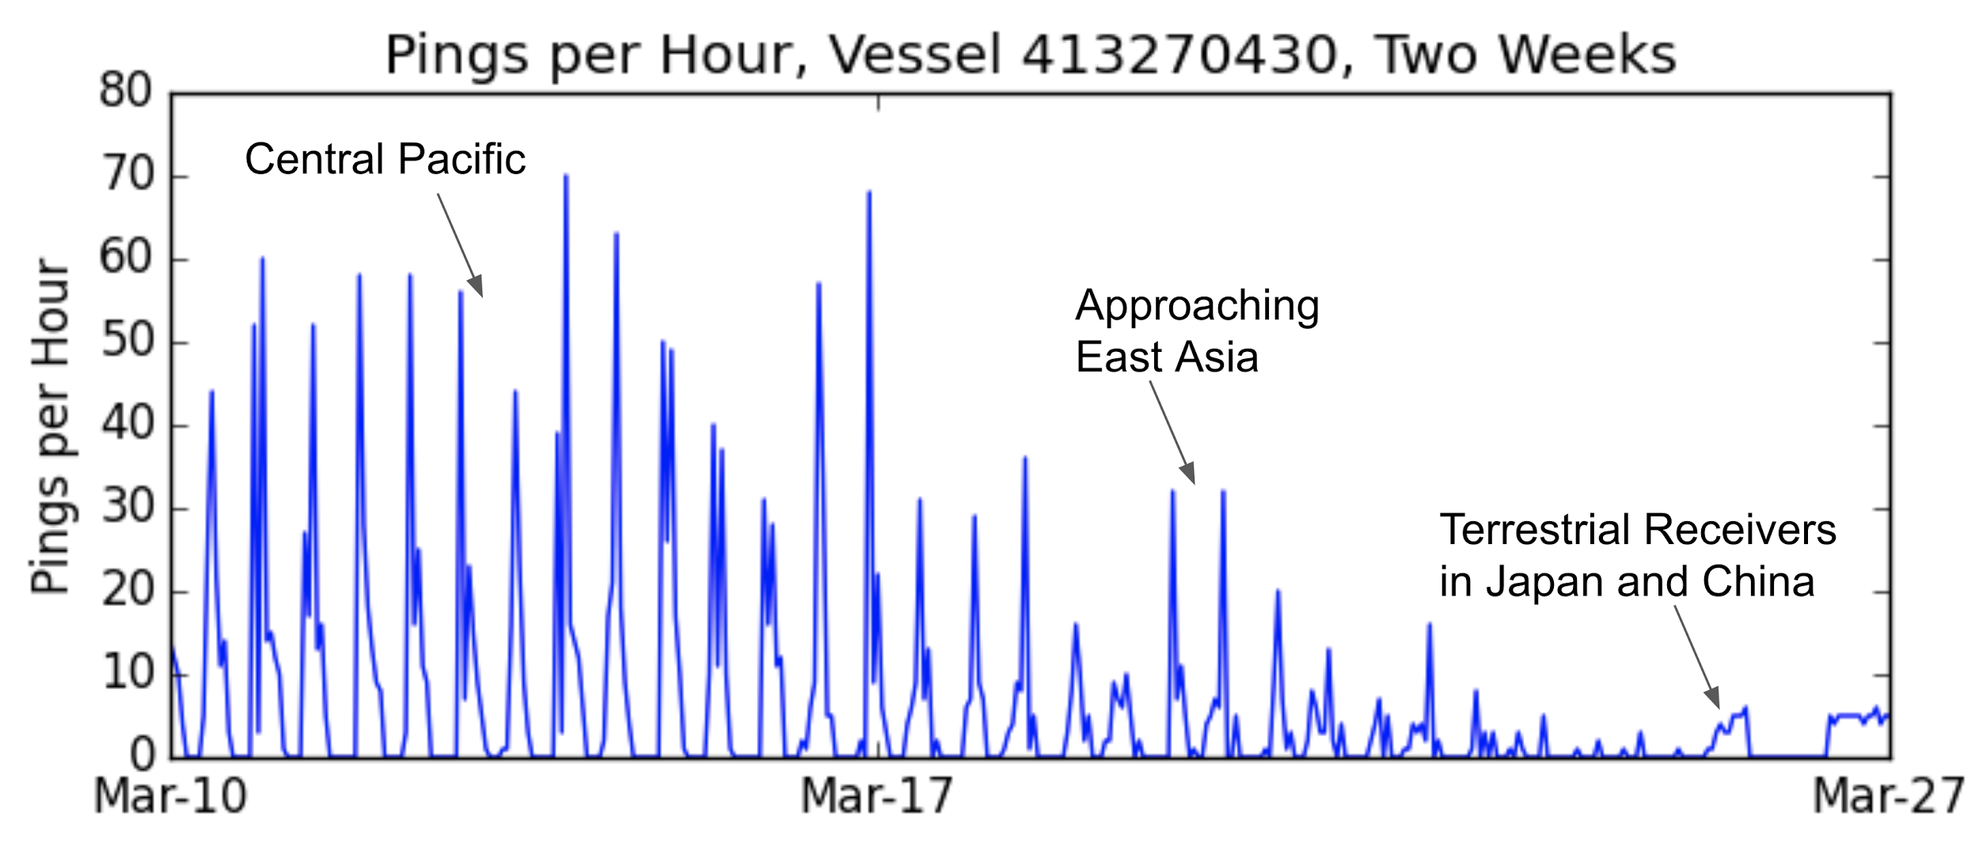
What is AIS:
How often does it broadcast?:
Depends on how the vessel is moving
Once every three to six minutes if sitting still.
Up to once every two seconds while moving.
And where in the world it is:

Slide 6
Types of messages:
Identity messages (types 5 & 24):
MMSI
Name
Callsign
IMO Number
Length (“to bow” “to stern”)
Vessel Type (“fishing” “tug”)
Destination
Position reports messages:
Type A device: pretty good
Type B device: sucks

Slide 7
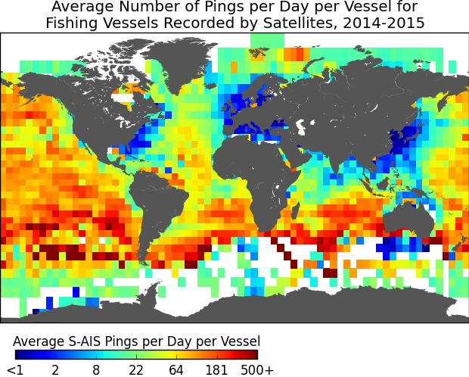
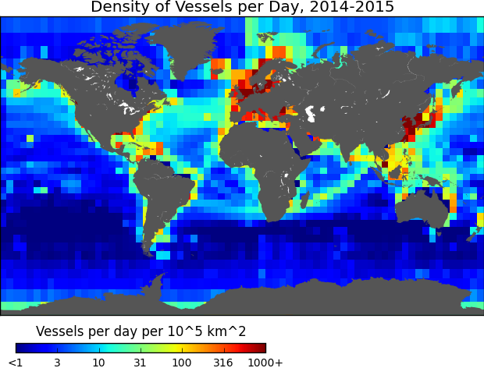
Coverage
S-AIS positions per day
Vessel density

Slide 8
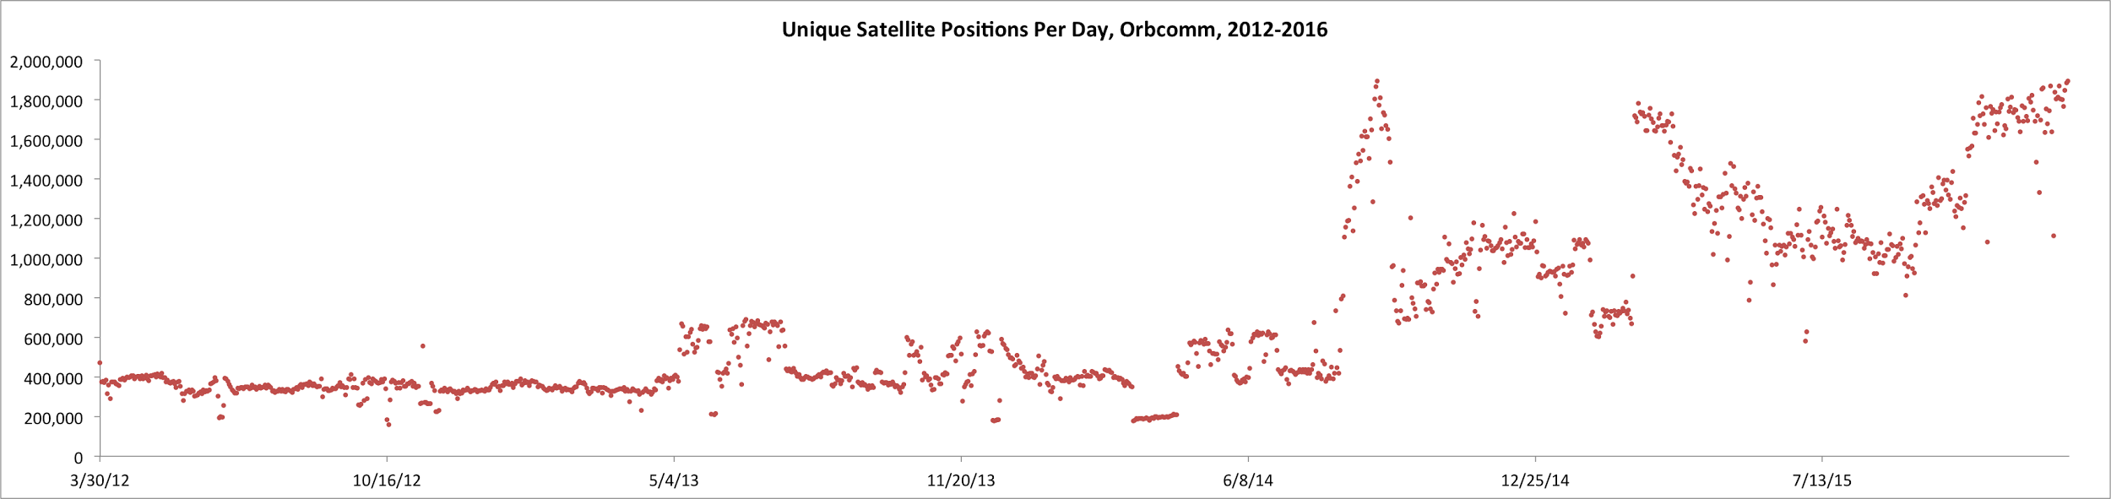
Improved AIS adoption

Slide 9
Use and Misuse of AIS
Multiple vessels using the same mmsi
Vessels turn off their AIS
Positions are intentionally offset

Slide 10
Vessel info
Each row is an mmsi and it’s characteristics for a specific calendar year
Only mmsi with at least 50 positions in a given year with a speed (from ais) greater than .1 knots are included -- includes fishing and non-fishing mmsi
How it’s done: https://github.com/GlobalFishingWatch/data-dev/blob/master/david/vessel_identity/List_Creation_2017-06-06.ipynb

Slide 11
Vessel info
on_fishing_list:
Our known and likely vessels that have > 100 positions in a year
Varies by year (some vessels are not on it in some years, and are in other years)
on_fishing_list_nn:
Vessels that the net identifies as fishing, which are not research vessels, and which are not known non-fishing vessels
Same list for all years

Slide 12
Vessel info
good_shiptype_msg:
the number of non-null shiptype messages
C_fishing:
number of shiptype messages that are fishing
fishing_msg_ratio:
ratio of c_fishing / good_shiptype_msg
shiptype_text:
most common shiptype text

Slide 13
Vessel info
iso3:
iso3 country code, based on MID code
country_name:
country name, based on MID code
average_length:
average length from the AIS
stddev_length:
standard deviation of length from the AIS data
number_distinct_lengths:
number of different lengths reported by AIS
avg_width:
average width from AIS

Slide 14
Vessel info
Shipname: most common shipname broadcast
Num_shipnames: number of distinct shipnames broadcast
Shipname_norm: normalized name of the vessel
Num_shipnames_norm: once normalized, the number of unique shipnames
imo:most common IMO number if a valid IMO number was broadcast
Num_imos: number of valid IMO numbers
Callsign: most common callsign
Num_callsign: number of unique callsigns broadcast

Slide 15
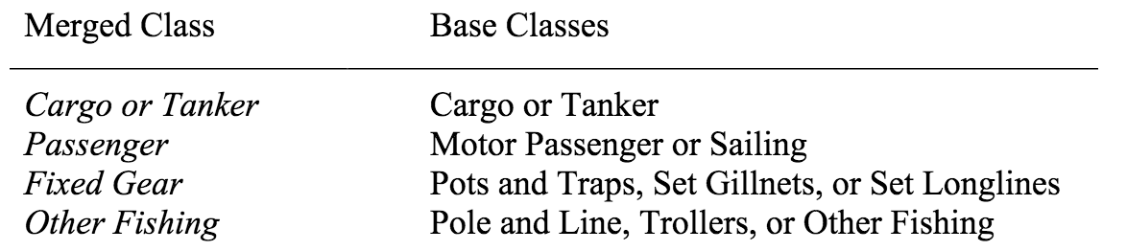
Vessel info
Inferred_label & inferred_sublabel:
the label/sublabel from the neural net for a specific year
label_score:
confidence of the net, from 0 to 1
inferred_label_allyears:
the best label across all years
label_score_allyears:
the score for that label across all years

Slide 16
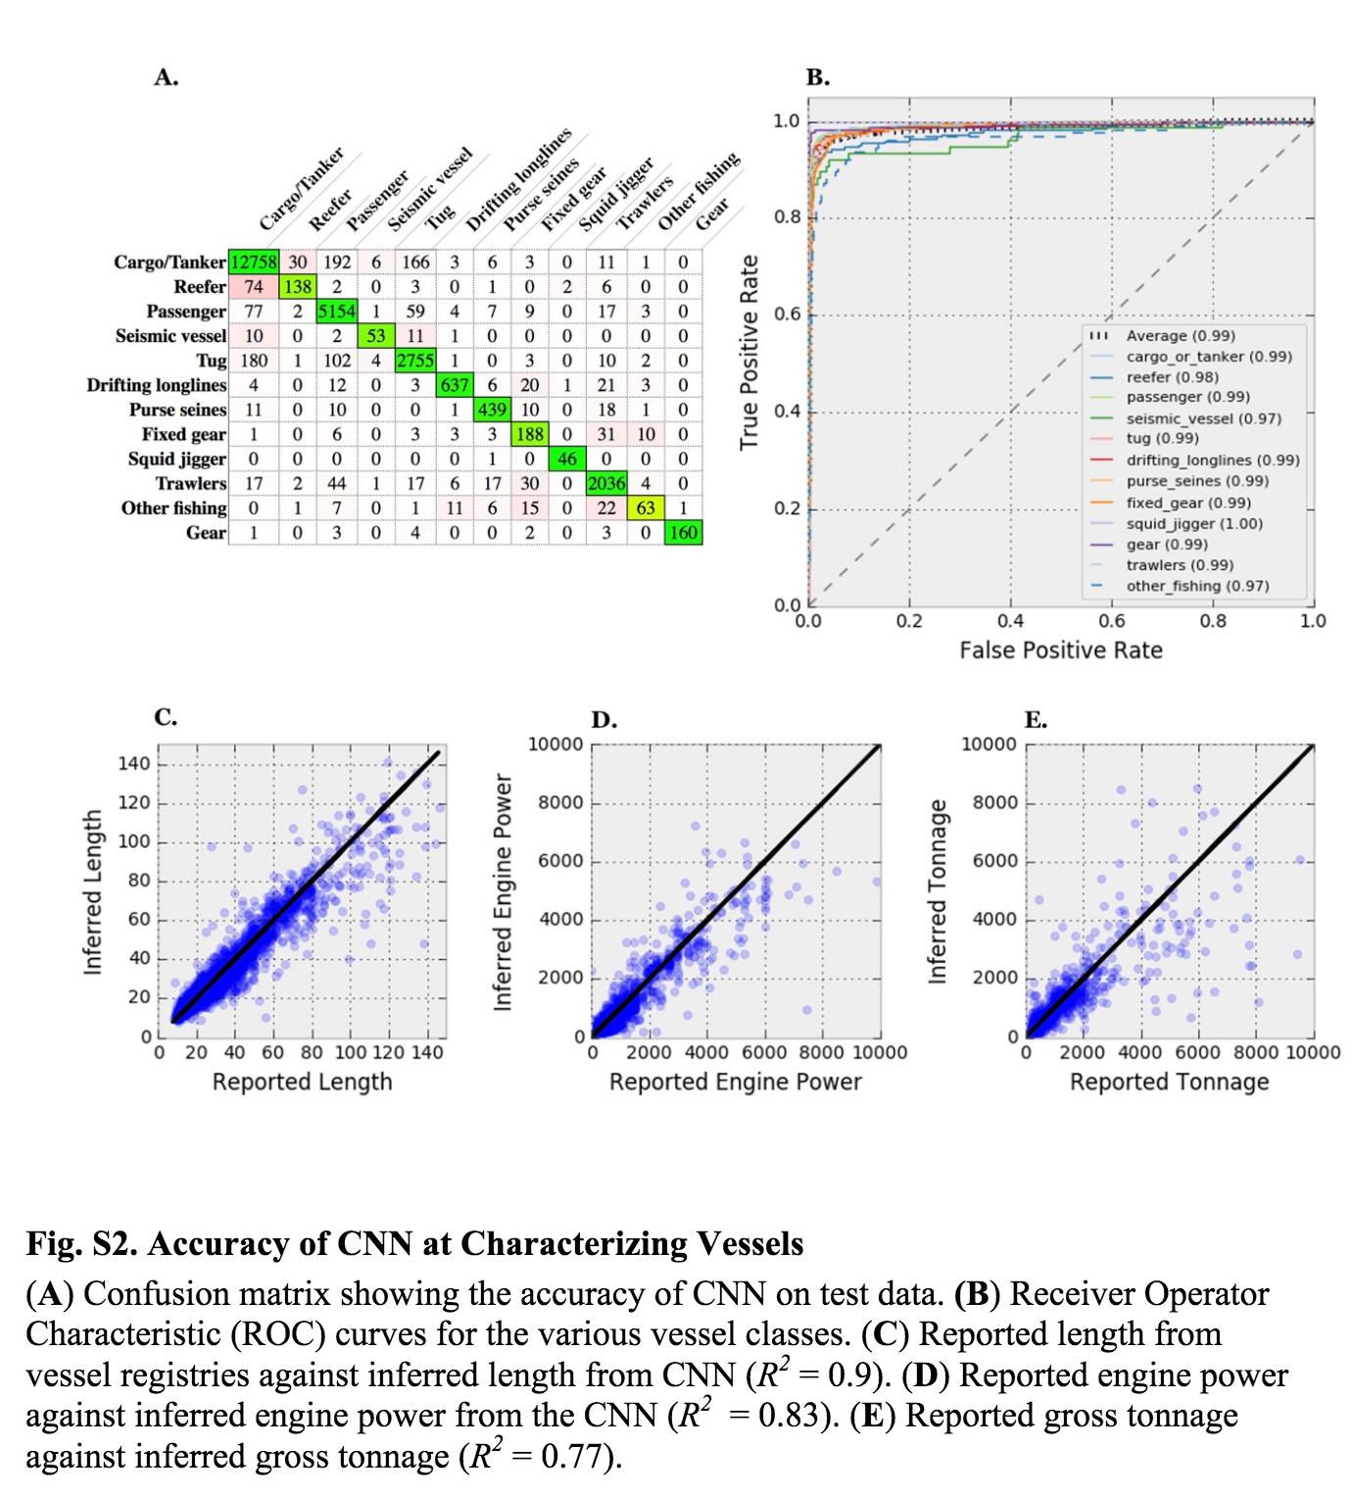
Vessel info

Slide 17
Vessel info
Training data:
Known_engine_power
Known_tonnage,
Training_listsource
Known_length
known_label
Much much much improved in the upcoming vessel_database

Slide 18
Vessel info
spoofing_factor: the segment_hours / tot_hours. If the mmsi has overlapping segments, this number will be greater than 1.
Jumps: jumps between two segments if you arrange all the points from an mmsi chronologically, including only jumps of bigger than 50 km.
avg_jump_dist_km -- average distance of these jumps

Slide 19
Vessel info
days: number of days with at least one point
active_days: days with at least one active point, including measure of 3 nautical miles from shore
active_days_speed: days with at least one active point, including only speed, and not the 3 nautical mile cutoff. In other words, if it is within 3 nautical miles, and has an active point, than it counts as an active day.
fraction_days_under_5: days with under 5 active points
fraction_days_under_10 : days with under 10 active points
fraction_days_under_20 : days with under 20 active points
fraction_days_under_30 : days with under 30 active points
*based on a count of active_points, which are points that are faster than .1 knot and more than 1 nautical miles from shore

Slide 20
Vessel info
fraction_time_terrestrial_rec: Fraction of time under Terrestrial Receivers
avg_dist_f_shore_nm : Average distance from shore, (averaged by time and not distance)
fraction_time_high_seas : Fraction of time on the high seas
frac_fishing_high_seas : Fraction of time fishing on the high seas (using measure new score and not nn_score)

Slide 21
Vessel info
eez_first : EEZ spends the most time in (will be ‘high seas’ if high seas is first)
eez_second : EEZ spends the 2nd most time in (will be ‘high seas’ if high seas is first)
frac_in_eez_first : fraction of time in first eez
frac_in_eez_second : fraction of time in second EEZ
fishing_days : fishing days using measure_new_score
fishing_days_nn : fishing days using nnet_score
fishing_hours_nn : fishing hours using nnet_score
offsetting : is it on our list of manually curated mmsi that offset their position

Slide 22
Some Queries

Slide 23
Search for a particular vessel
SELECT
*
FROM
[world-fishing-827:gfw_research.vessel_info]
WHERE
shipname_norm == "MONTEALEGRE"
AND year == 2016
Notes:
MONTEALEGRE

Slide 24
Get the number of purse seiners >36 meters by country and year
SELECT
year,
country_name,
EXACT_COUNT_DISTINCT(mmsi) n_vessels
FROM
[world-fishing-827:gfw_research.vessel_info_20170717]
WHERE
inferred_length > 36
AND inferred_label_allyears == "purse_seines"
AND (on_fishing_list
OR on_fishing_list_nn)
GROUP BY
year,
country_name
HAVING
n_vessels > 10
order by n_vessels desc

Slide 25
Find vessels that spend most of their time in Colombia’s EEZ but are not Colombian flagged
SELECT
iso3,
EXACT_COUNT_DISTINCT(mmsi)
FROM
[world-fishing-827:gfw_research.vessel_info_20170717]
WHERE
iso3 != "COL"
AND eez_first == "Colombia"
GROUP BY
iso3
order by 2 desc

Slide 26
Positional Messages
Table: [world-fishing-827:gfw_research.nn]
Each row is a single AIS position for the union of known, likely and suspected fishing vessels only
mmsi: vessel id
timestamp: timestamp
lat:
lon:
hours: half the time between next and last positions
hours12: half the time between next and last positions adding 24 hours to the start and end of a segment
measure_new_score: results from the old logistic regression model. Continuous variable between 0-1.
nnet_score: inferred fishing activity from new neural net model. 1 = fishing, null = not fishing
implied_speed: estimated from the positions
avg_distance_km: estimated from the positions
ais_speed: as measured by the AIS device

Slide 27
Positional Messages
Table: [world-fishing-827:gfw_research.nn]
Each row is a single AIS position for the union of known, likely and suspected fishing vessels only
flag_country_name:
flag_iso3:
eez_name:
eez_iso3:
distance_from_shore: in progress,
distance_from_port: in progress,
seg_id: id of the segment the position belong to.
regions: a terrible array with relevant areas this positions falls within:
Ocean Basin
EEZ
RFMO
MPA not take
MPA restricted use
FAO Region
EBSA
VMEs

Slide 28
Some Queries

Slide 29
Fishing effort inside a bounding box
http://boundingbox.klokantech.com/

Slide 30
Number of vessels fishing in Antarctica’s FAO regions
Notes:
SELECT
INTEGER(REGEXP_REPLACE( IF(REGEXP_EXTRACT(regions,'\"(fao:.*?)\"') CONTAINS ".", LEFT(REGEXP_EXTRACT(regions,'\"(fao:.*?)\"'),INSTR(REGEXP_EXTRACT(regions,'\"(fao:.*?)\"'),".")-1),REGEXP_EXTRACT(regions,'\"(fao:.*?)\"')), '[^0-9 ]','')) FAO_region,
EXACT_COUNT_DISTINCT(mmsi) n_vessels
FROM
[gfw_research.nn]
WHERE
_PARTITIONTIME BETWEEN TIMESTAMP('20146-12-01')
AND TIMESTAMP('2016-12-31')
AND lat < 80
AND lat > -80
AND lon < 180
AND lon > -180
and distance_from_shore < 1852*200
AND seg_id IN (
SELECT
seg_id
FROM
[world-fishing-827:gfw_research.good_segments])
GROUP BY
FAO_region
HAVING
FAO_region IN (88,
48,
58)

Slide 31
Summary of the U.S fishing effort on the WCPFC region excluding the high seas
Notes:
SELECT
YEAR(timestamp) year,
mmsi,
EXACT_COUNT_DISTINCT(DATE(timestamp )) days,
EXACT_COUNT_DISTINCT(IF(nnet_score == 1, DATE(timestamp), NULL )) fishing_days,
SUM(IF(nnet_score == 1, hours, 0)) fishing_hours,
FROM
[world-fishing-827:gfw_research.nn]
WHERE
_PARTITIONTIME BETWEEN TIMESTAMP("2015-01-01")
AND TIMESTAMP("2016-12-31")
AND (distance_from_shore > 1000
OR (implied_speed > .1
AND implied_speed < 20))
AND REGEXP_MATCH(regions,'\"ocean:pacific"')
AND REGEXP_MATCH(regions,'\"rfmo:WCPFC"')
AND (eez_name IS NOT NULL)
GROUP BY
year,
mmsi

Slide 32
Monthly raster of effort by the U.S longline fleet in the Pacific Ocean
Notes:
SELECT
year,
month,
gear_type,
lat_bin_center,
lon_bin_center,
eez_name,
eez_iso3,
SUM(hours) fishing_hours,
FROM (
SELECT
a.year year,
a.month month,
a.timestamp timestamp,
a.mmsi mmsi,
b.gear_type gear_type,
a.lat_bin_center lat_bin_center,
a.lon_bin_center lon_bin_center,
a.eez_name eez_name,
a.eez_iso3 eez_iso3,
a.regions regions,
a.hours hours,
a.nnet_score nnet_score
FROM (
SELECT
YEAR(timestamp) year,
MONTH(timestamp ) month,
timestamp,
mmsi,
FLOOR(lat*2)/2 +.25 lat_bin_center,
FLOOR(lon*2)/2 + .25 lon_bin_center,
eez_name,
eez_iso3,
regions,
hours,
nnet_score
FROM
[world-fishing-827:gfw_research.nn]
WHERE
_PARTITIONTIME BETWEEN TIMESTAMP("2013-01-01")
AND TIMESTAMP("2017-06-31")
AND REGEXP_MATCH(regions,'\"ocean:pacific"')
and (eez_name is null OR eez_name not in ("United States", "Alaska", "Canada"))
) a
INNER JOIN (
SELECT
year,
mmsi,
inferred_label AS gear_type,
FROM
[world-fishing-827:gfw_research.vessel_info]
WHERE
iso3 == "USA")b
ON
a.year = b.year
AND a.mmsi = b.mmsi)
WHERE
nnet_score == 1
and gear_type in ("purse_seines")
GROUP BY
year,
month,
gear_type,
lat_bin_center,
lon_bin_center,
eez_iso3,
eez_name

Slide 33
Gaps
[world-fishing-827:gfw_research.24hr_gaps_less_noise]
Each row represents a gap longer than 24 hours:
implied_speed_km_per_hour
gap_hours,
gap_km,
mmsi,
lat,
lon,
next_lat,
next_lon,
distance_from_shore_meters,
next_distance_from_shore_meters
timestamp,
next_timestamp

Slide 34
Some Queries

Slide 35
Gaps inside a bounding box
Notes:
SELECT
*
FROM
[world-fishing-827:gfw_research.24hr_gaps_less_noise]
WHERE
lat >= 0
AND lat <= 2
AND lon >= 70
AND lon <= 80
AND distance_from_shore_meters > 1851*50
AND next_distance_from_shore_meters > 1851*50
AND gap_hours > 25
AND mmsi IN (
SELECT
mmsi
FROM
[world-fishing-827:gfw_research.vessel_info_20170717]
WHERE
(on_fishing_list_nn
OR on_fishing_list)
AND inferred_label_allyears != 'gear')

Slide 36
Workflows

Slide 37
Best practices
Start querying from Big Query and not R/Phyton.
Autocompletion
Billing info
Debugging is easier
Shareable with GFW folks
Save large queries for reusability
1TB of processing = $6
Avoid writing for loops or mapping functions
Grouping minimized billing so group as much as possible within the query
When in doubt, reach out
If you want to learn more go to: http://globalfishingwatch.io/

